Slide 1
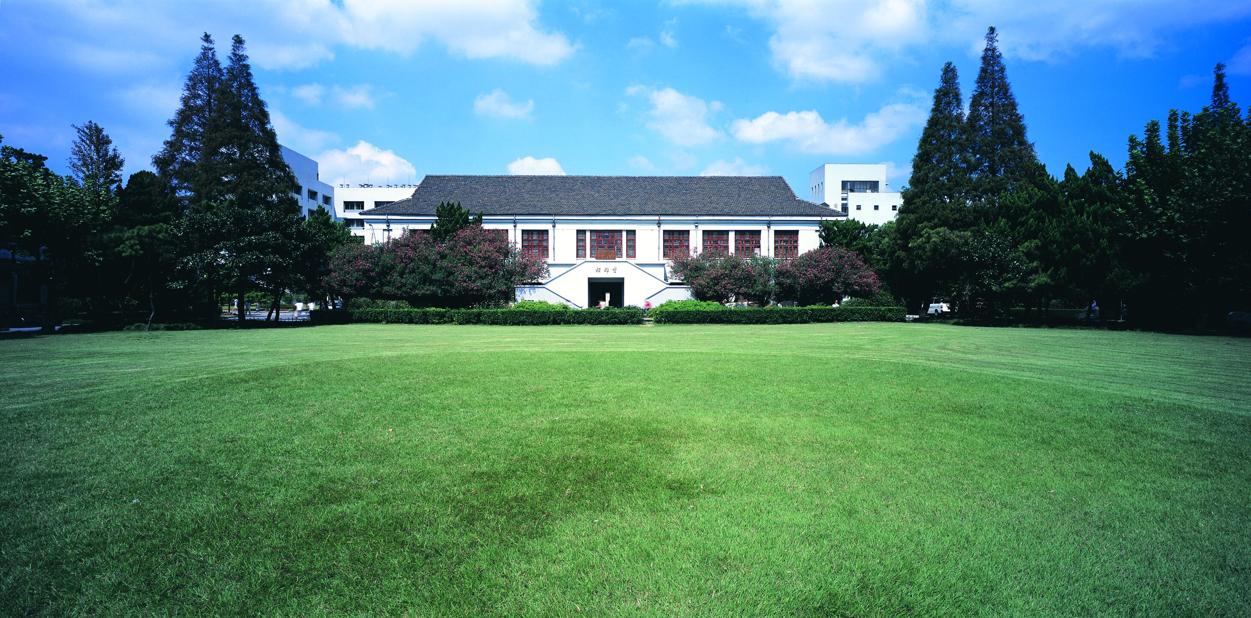
智能视频监控技术
MS-Net Mixed-Supervision Fully-Convolutional Networks for Full-Resolution Segmentation
Meet P. Shah, S. N. Merchant and Suyash P. Awate
MICCAI 2018
徐际岚 18210240039
Notes:
医学图像工作，MICCAI
网络结构本身平凡，Idea契合，（Low-level vision, Taskonomy）

Slide 2
智能视频监控技术
Outline
Introduction and Related Work
Methods
Implementations and Results
Discussions
je
MS-Net

Slide 3
Introduction & Related Work
1

Slide 4
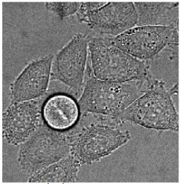

Introduction & Related Work
Bottlenecks in Biomedical Image Analysis
Quantity and quality of data
Time-consuming annotations
WSI and full resolution image process
Inter and intra class imbalance
MS-Net
Notes:
数量少，质量低
标注成本高（亲自标食管癌病理数据经验，2k*3k 专业医学生需要一周）
对Whole slide image利用patch的处理方式，在全分辨率下降采样的信息损失，多尺度信息融合（encoder-decoder, 金字塔，Dilated Conv, 级联或并联模块（ASPP））, Mask RCNN 不能完成全分辨率的处理
正常图片多，癌图少 —— 每张图中正常细胞多，癌细胞区域少

Slide 5
Introduction & Related Work
Solutions
High quality, strong supervision
Segmentation
Low quality, weak supervision
Detection, Landmarks
Strong and weak supervision
Bootstrapped dice loss
Dilated Convolutions
MS-Net

Slide 6
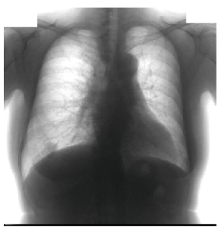
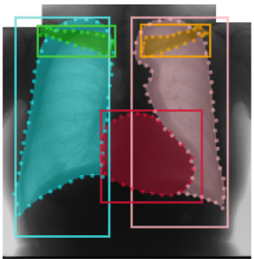

Introduction & Related Work
Raw Image
Ground Truth
Proposed
MS-Net

Slide 7
Methods
2

Slide 8
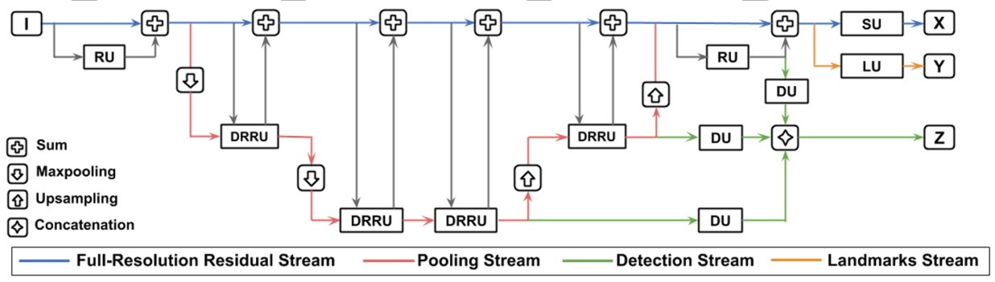
Methods
Network Architecture
Pohlen T , Hermans A , Mathias M , et al. Full-Resolution Residual Networks for Semantic Segmentation in Street Scenes[J]. 2016.
MS-Net

Slide 9
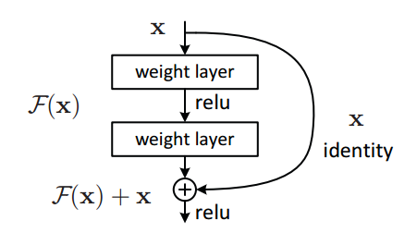
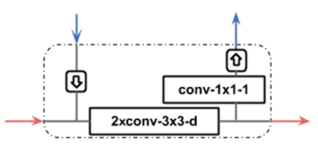
Methods
Network Architecture
Residual Unit
Dilated Full-Res Residual Unit
MS-Net

Slide 10
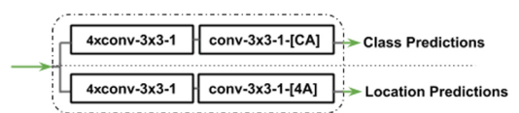
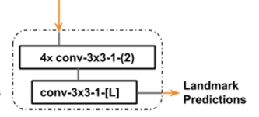
Methods
Network Architecture
Detection Unit
Landmark Unit
MS-Net

Slide 11
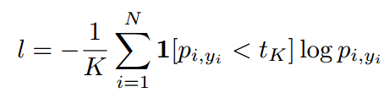
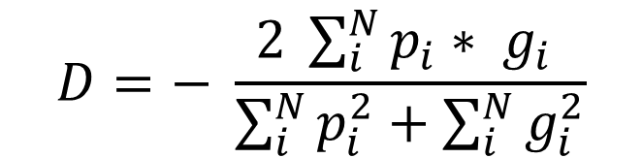
Methods
Loss Function
Segmentation：Bootstrapped dice loss
Bootstrapped CE loss:
$$D=− \frac{2 \sum_{i}^{N}{p_{i}∗ g_{i}} }{\sum_{i}^{N}{p_{i}^{2}}+\sum_{i}^{N}{g_{i}^{2}}}$$
Dice loss:
Wu, et al. "Bridging category-level and instance-level semantic image segmentation." arXiv preprint arXiv:1605.06885 (2016).
Milletari, et al "V-net: Fully convolutional neural networks for volumetric medical image segmentation." 3D Vision (3DV), 2016 Fourth International Conference on. IEEE, 2016.
MS-Net
Notes:
不需要预先设置class weight

Slide 12

Methods
Loss Function
Landmark：Cross entropy loss
Focal loss (Classification)
Detection:
L1 loss (Localization)
Lin, Tsung-Yi, et al. "Focal loss for dense object detection." IEEE transactions on pattern analysis and machine intelligence (2018).
MS-Net
Notes:
Gamma = 2
Pt 表示难易程度，pt = p (y = 1) or (1-p) (y = 0), pt越大越确信为某一类

Slide 13
Implementation and Results
3

Slide 14
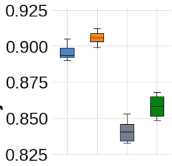
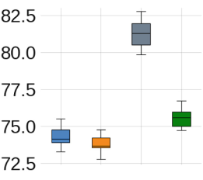
Implementations and Results
Object Dice
Object Hausdorff Distance
MS-Net
Notes:
Hausdorff = max(

Slide 15
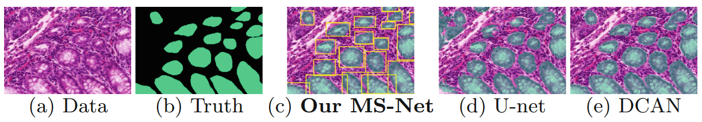
Implementations and Results
Visualization
MS-Net

Slide 16
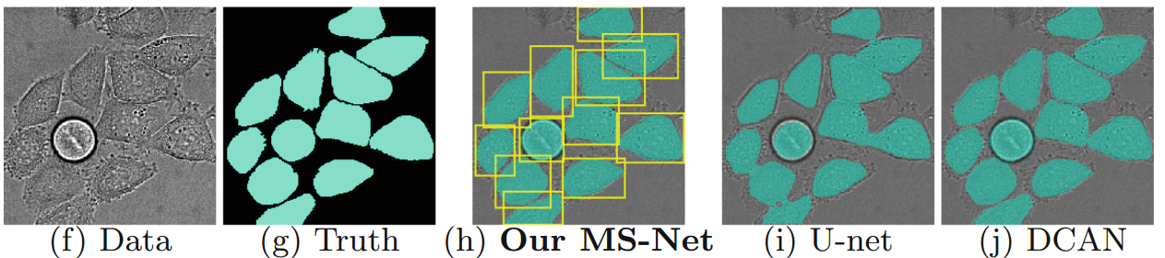
Implementations and Results
Visualization
MS-Net

Slide 17
Discussions
4

Slide 18
Discussions
Discussions
Ablation study for dilated convolutions
L1 loss → smooth L1 loss
DCAN with weak supervisions
je
MS-Net
Notes:
F(x) = 0.5 x^2 (|x| < 1)
F(x) = |x| - 0.5 (else)

